Slide 1
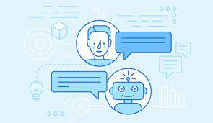
A chatbot using language processing to answer customer service inquiries for a business. By: Harshitha Patil, Vineesha Chowdary, Jashwanth Potlapelli, Achyut Kumar

Slide 2

Research work that have been conducted:
A study of consumer experiences" by Alexander J. F. Sehlström and Ana García-Hernández (2019). This study explored how customers perceive and interact with chatbots in customer service settings.
Evaluating Chatbots using a Conversational Analysis Framework" by Shilpa Arora and Ruchi Mahindru (2020). This research work proposed a framework for evaluating chatbots using conversational analysis.
An Evaluation of Chatbot User Interfaces for Customer Service" by Elizabeth Sanfilippo and Robin Brewer (2021). This study compared the effectiveness of different chatbot user interfaces for customer service.

Slide 3
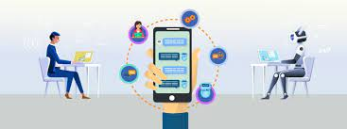
Introduction to our project prototype:
Chatbots using natural language processing (NLP) are computer programs that simulate human conversation through text or voice interactions.
They can answer customer inquiries, provide recommendations, and even handle complaints and issues, all while reducing the workload of human customer service representatives.
By implementing chatbots using NLP, businesses can provide customers with round-the-clock support, improve the speed and accuracy of customer service responses.
Overall, chatbots using NLP are a powerful tool for businesses to improve customer service and satisfaction.

Slide 4
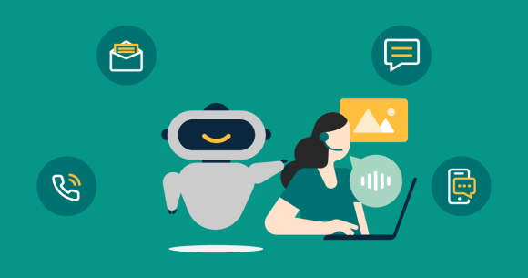
Approach to our prototype:
Identify business goals and customer needs
Define chatbot scope and design
Develop the chatbot using NLP technology
Integrate the chatbot with other business systems
Continuously improve and update the chatbot

Slide 5
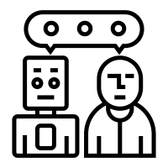
Purpose of our project:
The purpose of a chatbot using natural language processing (NLP) to answer customer service inquiries for a business is to provide an efficient and effective way for customers to get their questions answered and problems resolved quickly.
By using NLP, the chatbot can understand and interpret the natural language used by customers, allowing for a more natural and conversational interaction. This helps to reduce the workload of human customer service agents, freeing them up to focus on more complex and high-level customer issues.
Additionally, chatbots can collect data on customer interactions, which can be used to identify common customer concerns and areas for improvement in the customer service experience. Overall, the purpose of a chatbot using NLP for customer service is to provide a more efficient, effective, and convenient way for customers to get the help they need from a business.

Slide 6
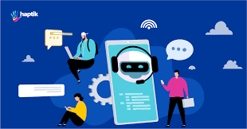
Scope of the model:
Handling simple inquiries
Providing personalized recommendations
Conducting surveys and collecting feedback
Resolving complaints and issues
Integrating with other systems

Slide 7



Software Requirements:
Programming Language: Python
NLP Library
Platform: Google Collab
Database: We will use a database to store and manage user data and chat logs. We will use databases SQL.
Version Control System: We will use a version control system like Git to manage the source code of your chatbot.

Slide 8
Steps to develope chatbot :
Read the data
Pre-process the data
Bag of words
Deployment

Slide 9
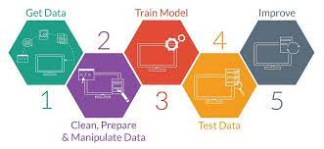
Methodology:
Define and problem
Gather data
Pre-process the data
Train the chatbot
Test the chatbot
Integrate the chatbot

Slide 10
Flow Diagram:
User Message
Intent classification
Entity resolution
Intent
Entity
AI Brain
Response Selection
Response with Highest Similarity

Slide 11
Conclusion:
Overall, this project aims to build a chatbot using NLP to answer customer service inquiries for a business.
The chatbot will be trained on a dataset of customer inquiries using machine learning algorithms to provide accurate and relevant responses.
The chatbot will be designed to handle a wide range of customer queries and provide a seamless customer experience, ultimately improving customer satisfaction for the business.
Future Considerations:
Advancements in NLP technology
Integration with other emerging technologies
Augmentation of human customer service representatives

